Slide 1

On Board Computing
Lt Col Miller
Notes:
Quickbird

Slide 2
Commanding
Telemetry
C&DHS

Slide 3
TT&C
Telemetry - The in situ collection of measurements or other data at remote points and their automatic transmission to receiving equipment for monitoring.
Telecommand
Tracking
Status of Health

Slide 4
CD&H
Command Data and Handling
Telecommand
Data handling
Components
On board Computer
Radio
Ground Station Equipment
Wire Harnesses
Protocols
Modulation
Data Frames

Slide 5
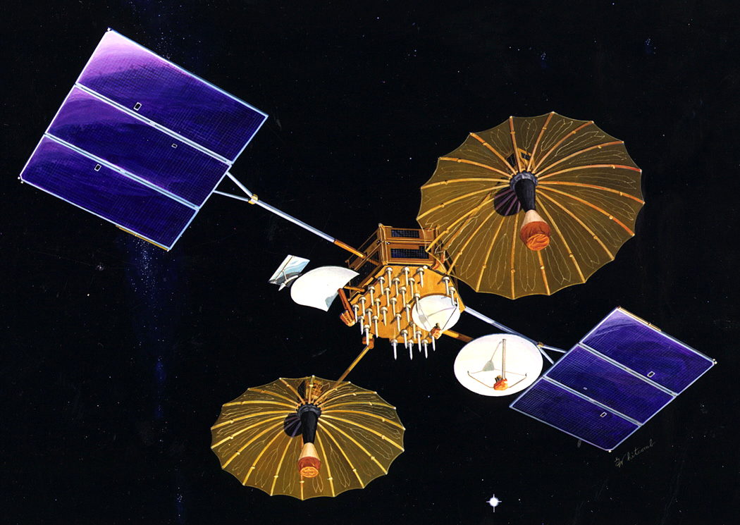
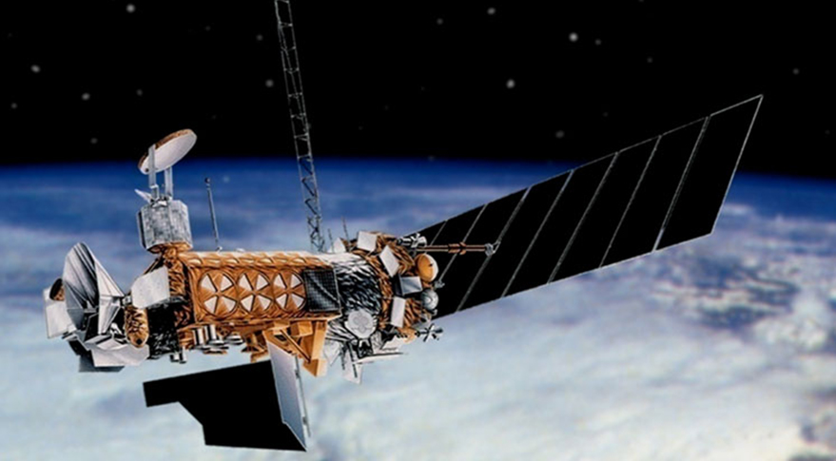
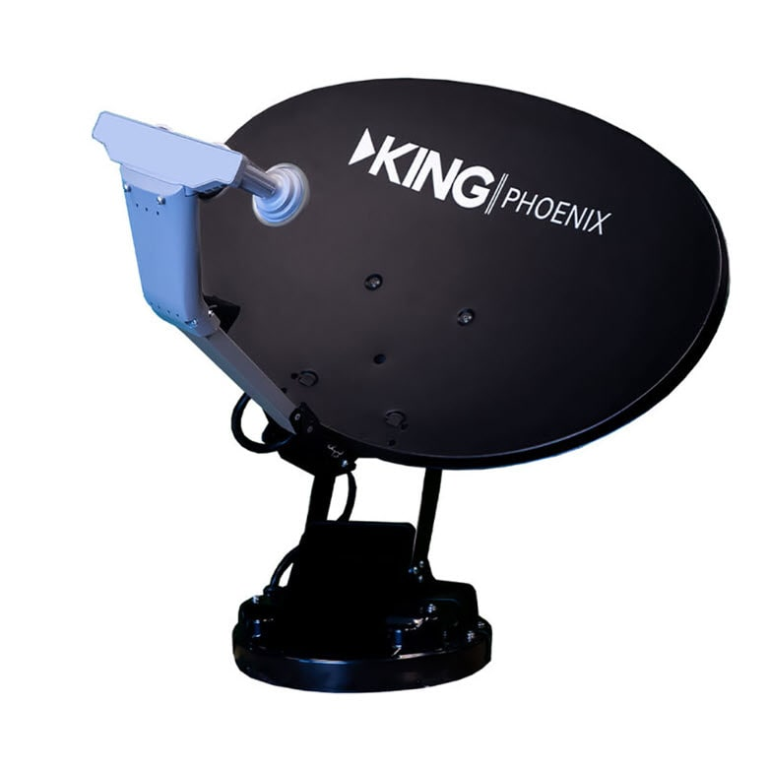
Comm Path
S/C to ground
ADC
Multiplexing – combining multiple signals
Modulation – putting info onto EM wave
Amplification
Ground to S/C
Amplification
Demodulation
Demultiplexing
DAC

Slide 6
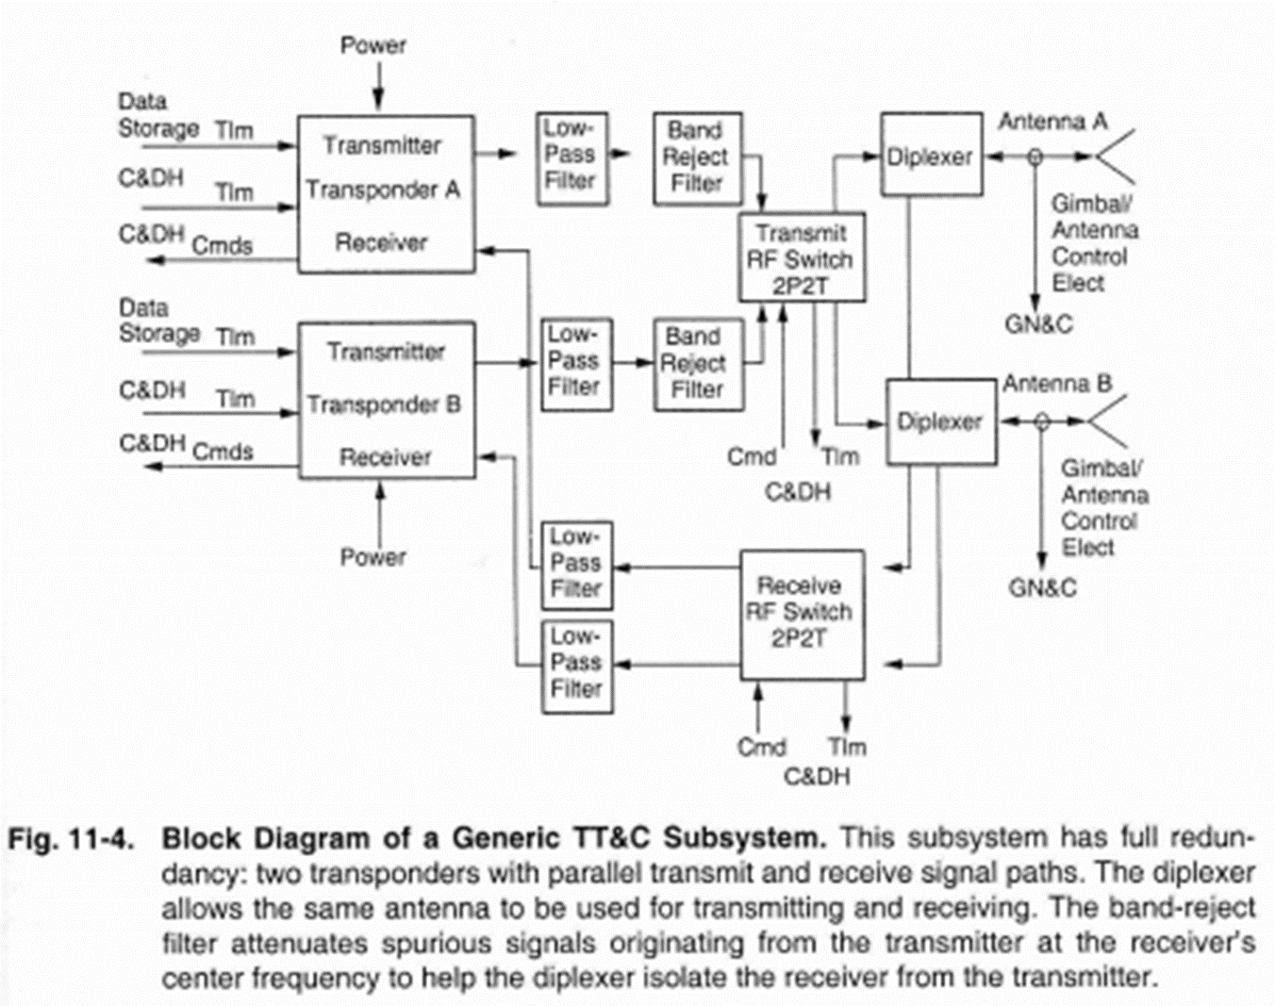

Slide 7
For 331
Computer
On board computing
Faults
Reliability
Radio – Comm lesson from before
Both COTS materials

Slide 8
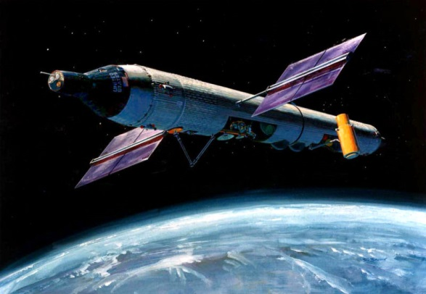

Slide 9
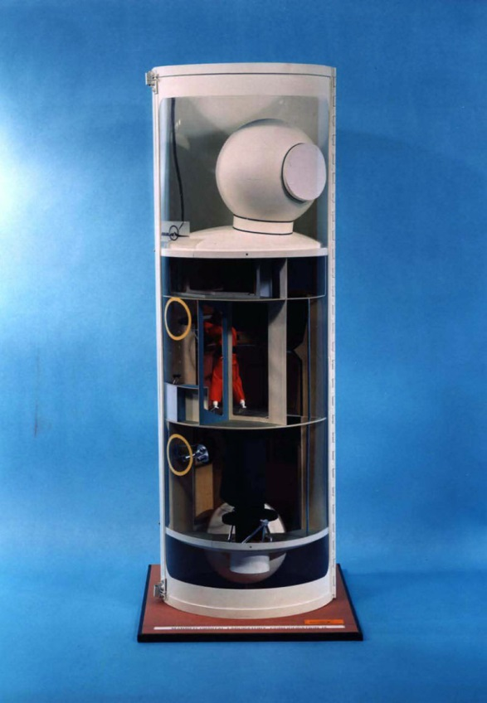
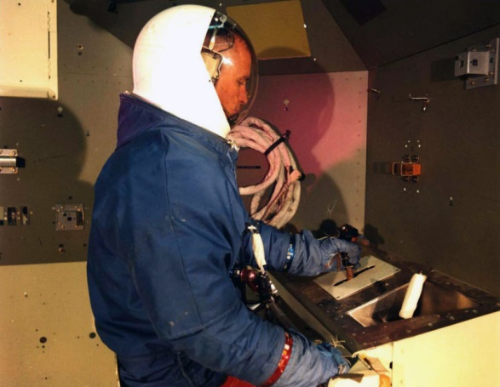

Slide 10
On Board Computer
Flight Computer
FlatSat – Arduino
Apollo – Bespoke 15 (16 bit computer)
DMSP – 32 K of memory
Space Shuttle – Intel 8086 (1MB of memory)
ISS – Intel i386 (state of the art for 1985)
Dragon – Linux based dual core x86 (2012)
C++, Python, HTML

Slide 11
What could go wrong?
software bugs
electrical design flaws
radiation effects
pre-launch corrosion
thermal-electrical stress
thermal-mechanical stress
mechanical stress during launch
manufacturing and assembly errors

Slide 12
Radiation Effects
single event effects
single event transient (SET) spurious signal
single event upset (SEU) state change (memory, storage, etc.)
single event latchup (SEL) switch closes and stays closed until a power cycle
bad if it shorts power to ground

Slide 13
Radiation Effects
total ionizing dose effects
cumulative radiation exposure
COTS tolerance: 1–10 krad
rad hard tolerance: 0.1–1 Mrad

Slide 14
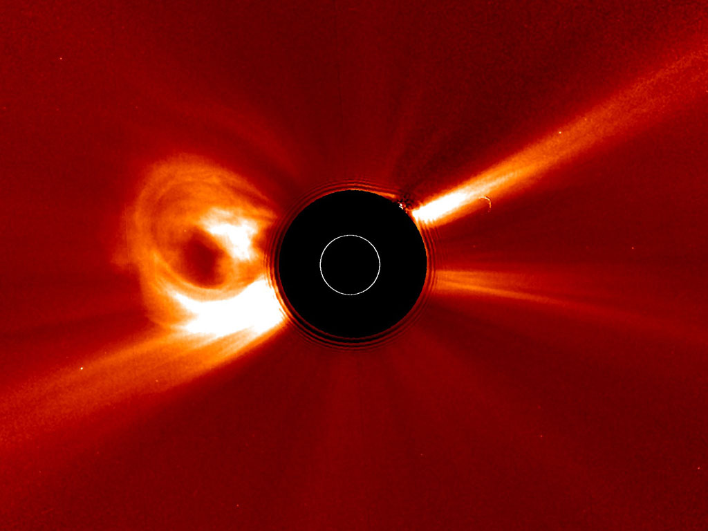
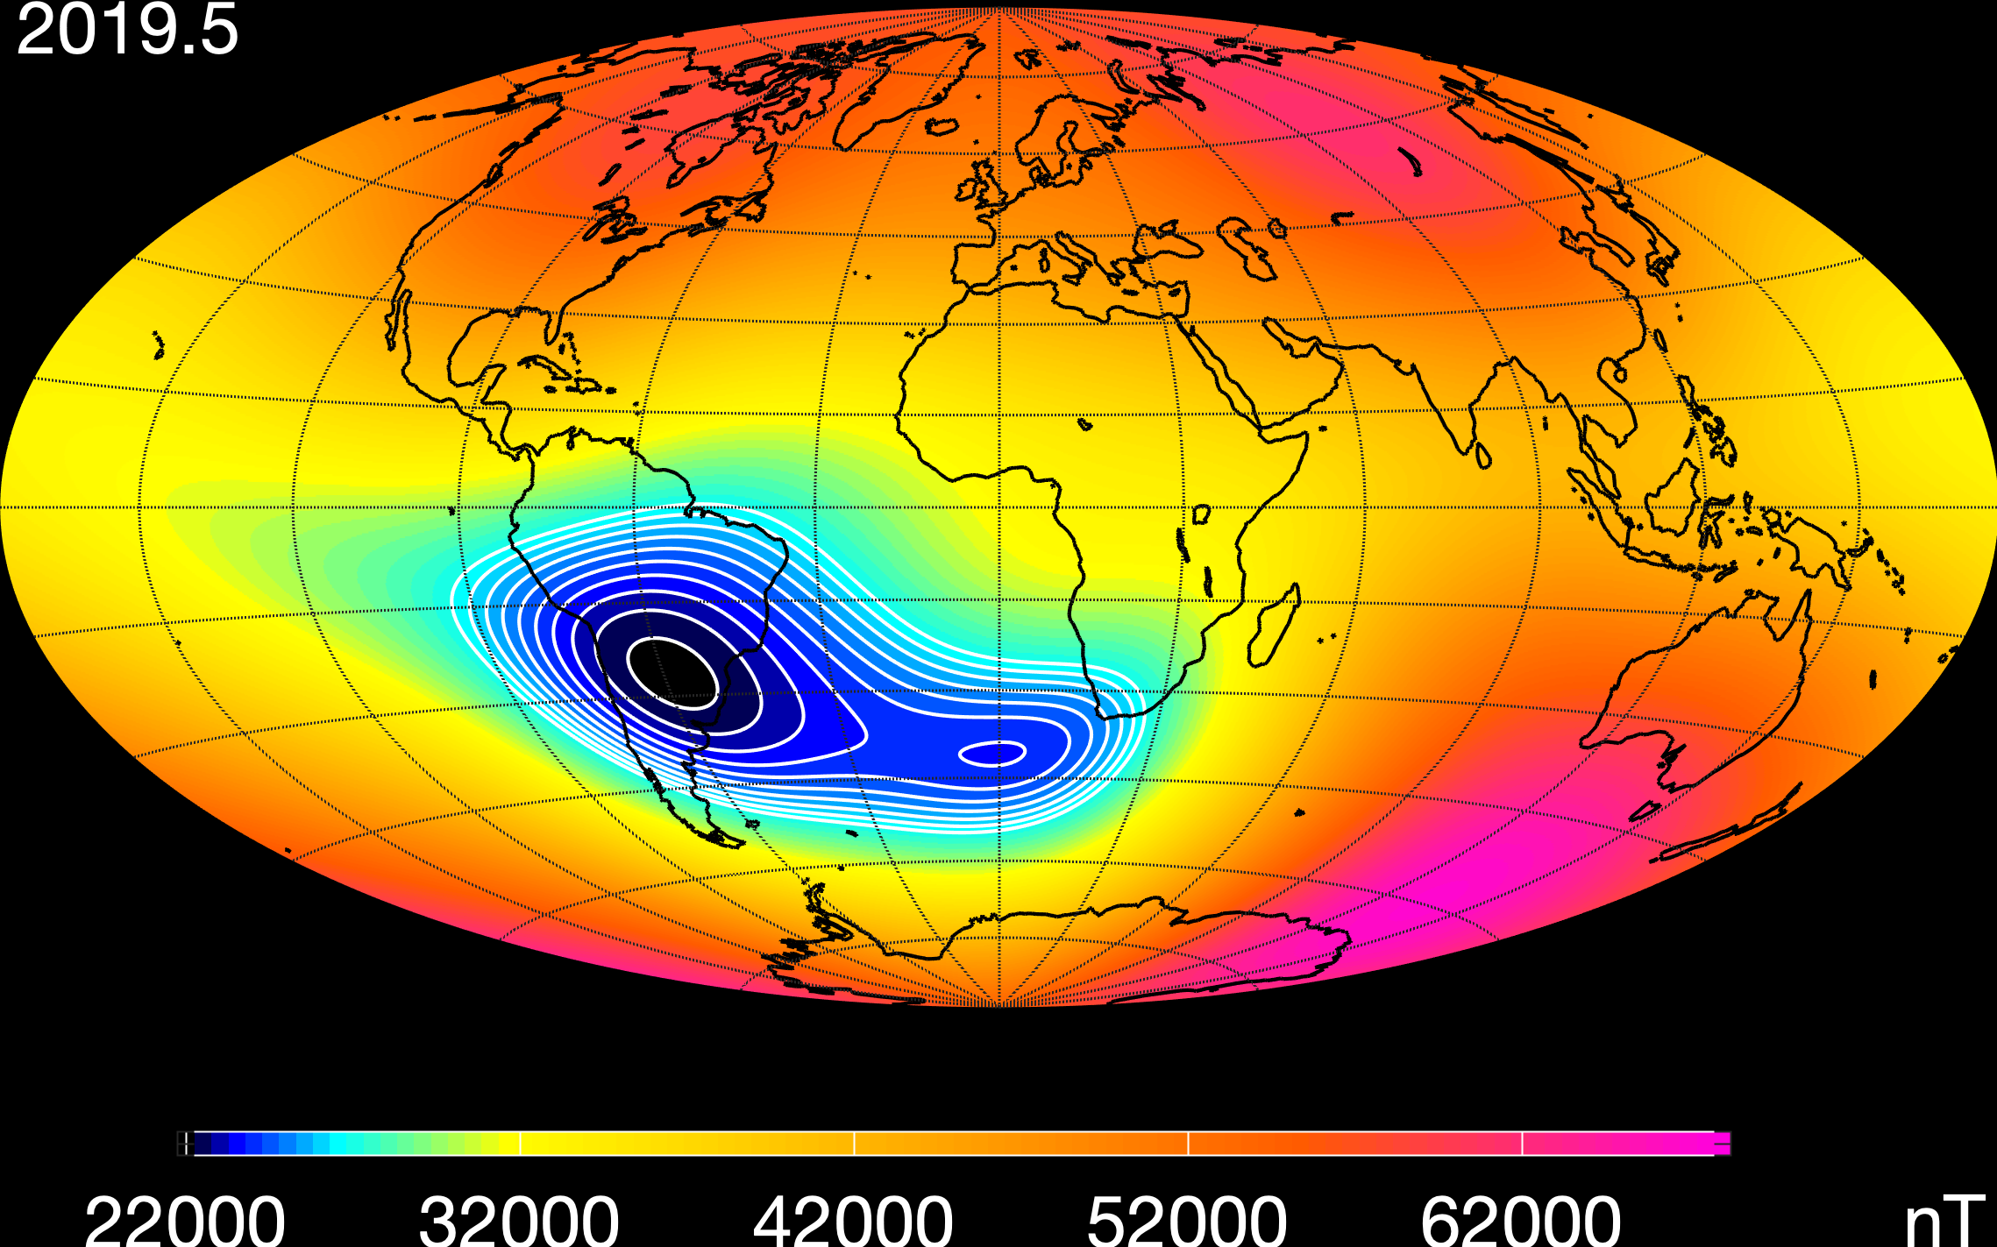

Slide 15
Faults
Fault: an unexpected response whereby the function is recoverable, either by fixing it, managing around it, or by redundancy
Fault tolerance: the number of faults that the system must tolerate to meet its specifications
Fault mitigation: the passive mitigation of faults through design
Examples: ARM/EXECUTE command pairs for hazardous commands, extra solar array strings

Slide 16
Faults
Fault protection: the implementation of design intended to actively control the effects of a fault
Limited to detecting and responding to discrete defects which may arise in the operation of an otherwise healthy space vehicle
Intended to detect faults (or the effect of a fault) and intervene so that the fault does not permanently affect the safety of the space vehicle
Safe Hold Mode

Slide 17
Faults
Fault management: an engineering discipline that addresses the occurrence of faults on the space vehicle and provides a means for reducing their effect through cooperative design of both the space vehicle and ground elements and operator actions; includes fault tolerance, fault mitigation and fault protection

Slide 18
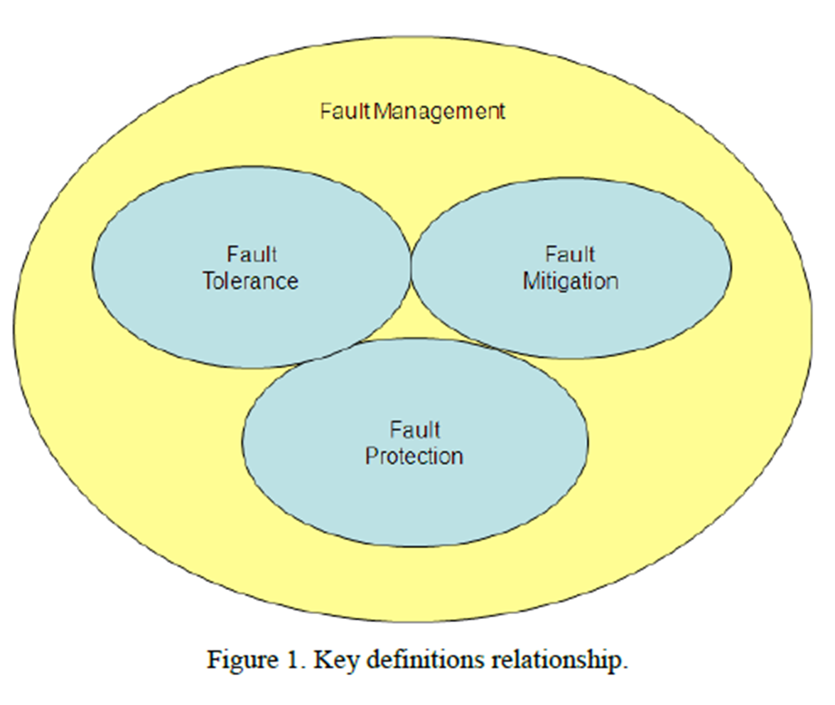

Slide 19
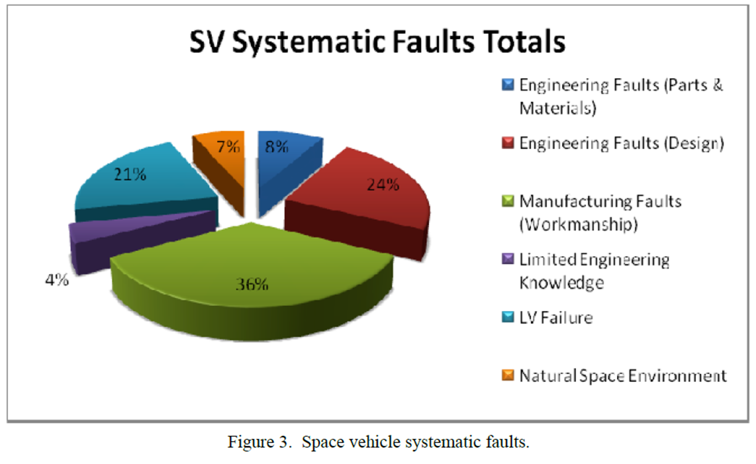

Slide 20
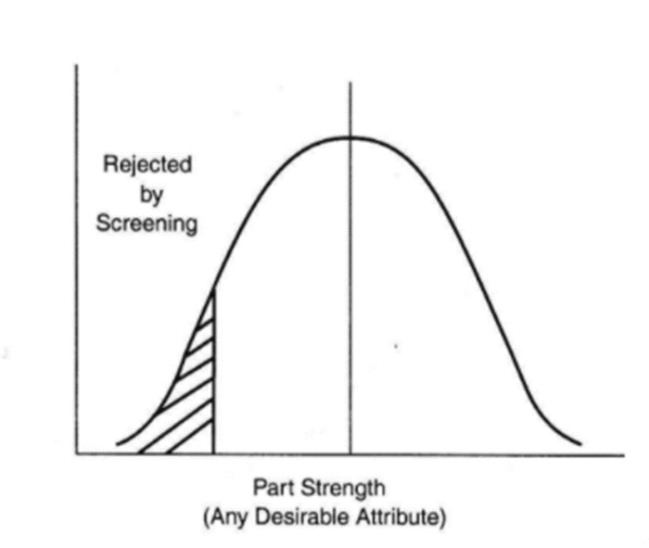
Non-Computer Failures
Part Screening – screen out part that are likely to fail in service

Slide 21
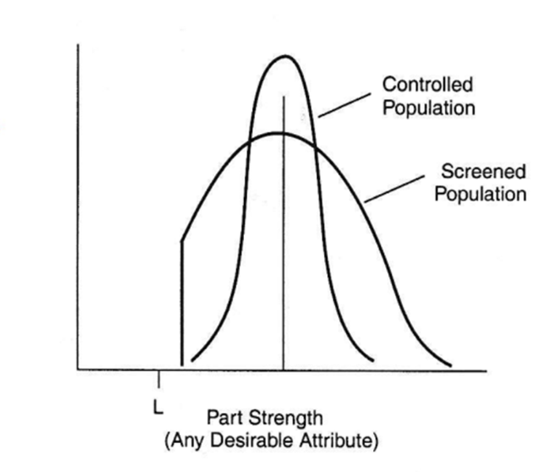
Non-Computer Failures
Process Control– screening the process of manufacturing the part

Slide 22
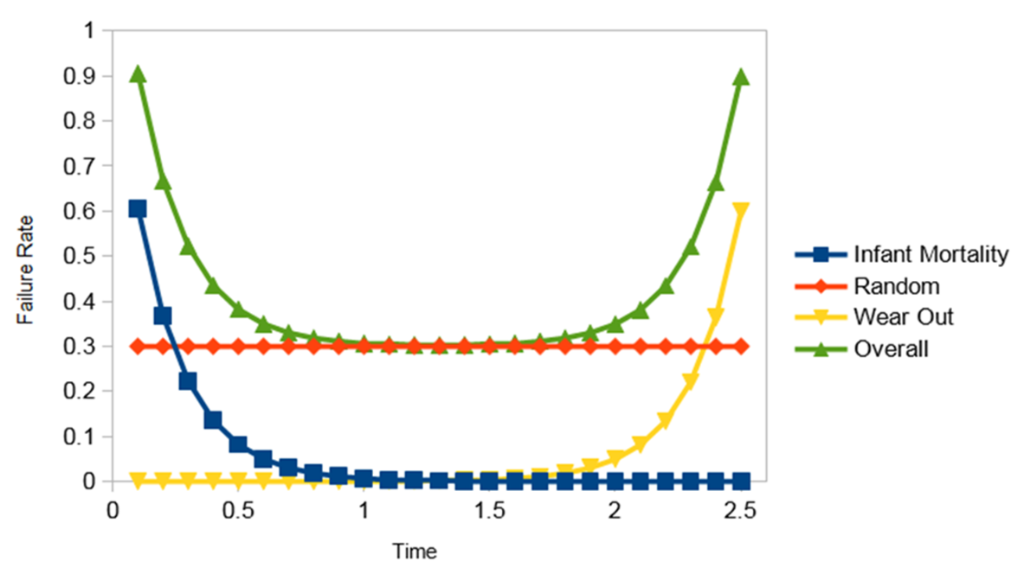
Reliability over Time

Slide 23
How to deal with Failures
Testing to prevent
Redundancy
Graceful Degradation

Slide 24
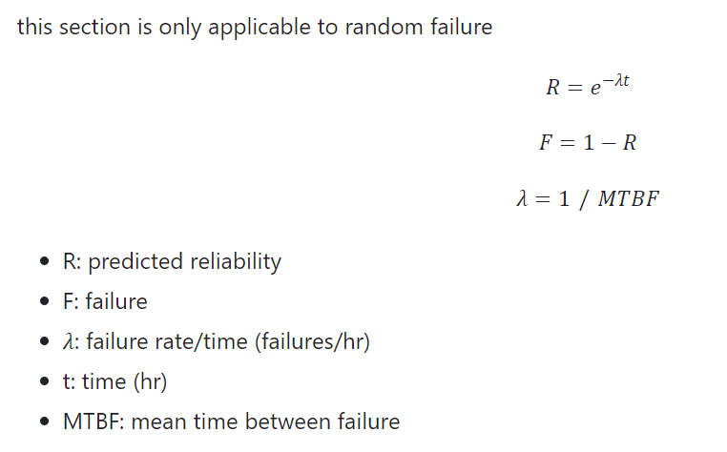
Reliability

Slide 25
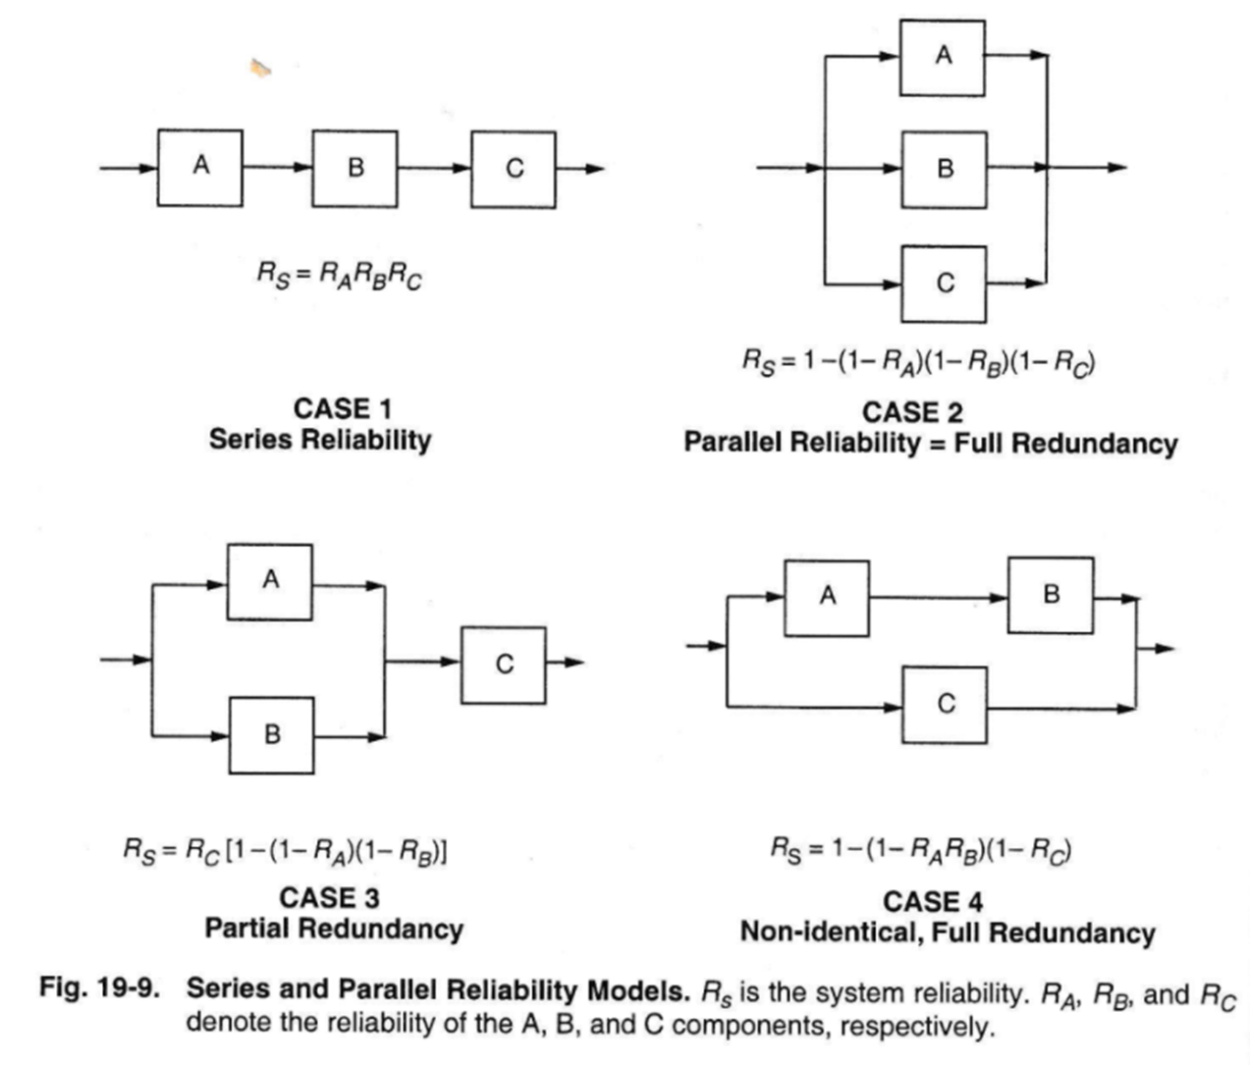

Slide 26
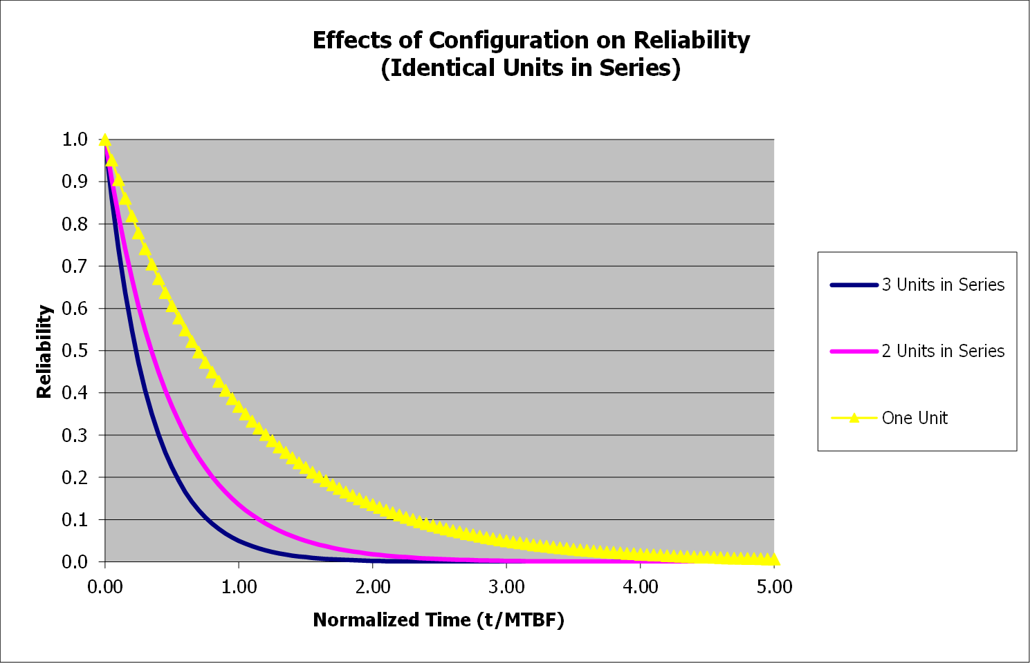

Slide 27
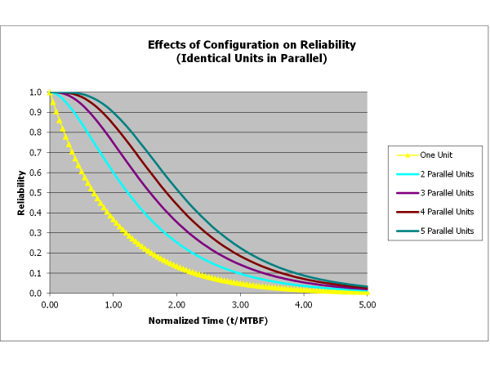

Slide 28
